Slide 1
Database
A database is an organized collection of structured information, or data, typically stored electronically in a computer system.
Data within the most common types of databases in operation today is typically modeled in rows and columns in a series of tables to make processing and data querying efficient.
The data can then be easily accessed, managed, modified, updated, controlled, and organized.
Most databases use structured query language (SQL) for writing and querying data.

Slide 2
Databases and spreadsheets (such as Microsoft Excel) are both convenient ways to store information. The primary differences between the two are:
->How the data is stored and manipulated
->Who can access the data
->How much data can be stored
Spreadsheets were originally designed for one user, and their characteristics reflect that.
They’re great for a single user or small number of users who don’t need to do a lot of incredibly complicated data manipulation.
Databases, on the other hand, are designed to hold much larger collections of organized information—massive amounts, sometimes. Databases allow multiple users at the same time to quickly and securely access and query the data using highly complex logic and language.

Slide 3
What is database software?
Database software is used to create, edit, and maintain database files and records, enabling easier file and record creation, data entry, data editing, updating, and reporting.
The software also handles data storage, backup and reporting, multi-access control, and security.
Strong database security is especially important today, as data theft becomes more frequent. Database software is sometimes also referred to as a “database management system” (DBMS).

Slide 4
MySQL database
MySQL is an open source relational database management system based on SQL. It was designed and optimized for web applications and can run on any platform. As new and different requirements emerged with the internet, MySQL became the platform of choice for web developers and web-based applications. Because it’s designed to process millions of queries and thousands of transactions, MySQL is a popular choice for ecommerce businesses that need to manage multiple money transfers. On-demand flexibility is the primary feature of MySQL.
MySQL is the DBMS behind some of the top websites and web-based applications in the world, including Airbnb, Uber, LinkedIn, Facebook, Twitter, and YouTube.

Slide 5
What is a database management system (DBMS)?
A database typically requires a comprehensive database software program known as a database management system (DBMS). A DBMS serves as an interface between the database and its end users or programs, allowing users to retrieve, update, and manage how the information is organized and optimized. A DBMS also facilitates oversight and control of databases, enabling a variety of administrative operations such as performance monitoring, tuning, and backup and recovery.
Some examples of popular database software or DBMSs include MySQL, Microsoft Access, Microsoft SQL Server, FileMaker Pro, Oracle Database, and dBASE.

Slide 6
Database challenges
Absorbing significant increases in data volume. The explosion of data coming in from sensors, connected machines, and dozens of other sources keeps database administrators scrambling to manage and organize their companies’ data efficiently.
Ensuring data security. Data breaches are happening everywhere these days, and hackers are getting more inventive. It’s more important than ever to ensure that data is secure but also easily accessible to users.
Keeping up with demand. In today’s fast-moving business environment, companies need real-time access to their data to support timely decision-making and to take advantage of new opportunities.
Managing and maintaining the database and infrastructure. Database administrators must continually watch the database for problems and perform preventative maintenance, as well as apply software upgrades and patches. As databases become more complex and data volumes grow, companies are faced with the expense of hiring additional talent to monitor and tune their databases.
Removing limits on scalability. A business needs to grow if it’s going to survive, and its data management must grow along with it. But it’s very difficult for database administrators to predict how much capacity the company will need, particularly with on-premises databases.
Ensuring data residency, data sovereignty, or latency requirements. Some organizations have use cases that are better suited to run on-premises.

Slide 7
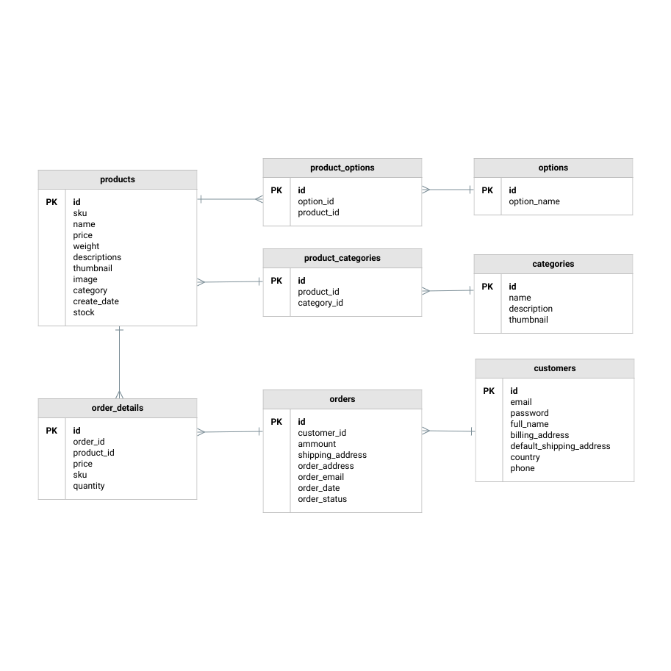
Types of databases
There are many different types of databases. The best database for a specific organization depends on how the organization intends to use the data.
(1)Relational Database
Relational databases
in a relational database are organized as a set of tables with columns and rows. Relational database technology provides the most efficient and flexible way to access structured information.

Slide 8
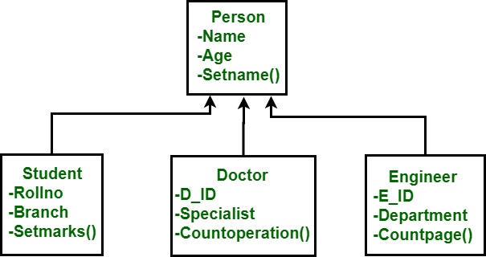
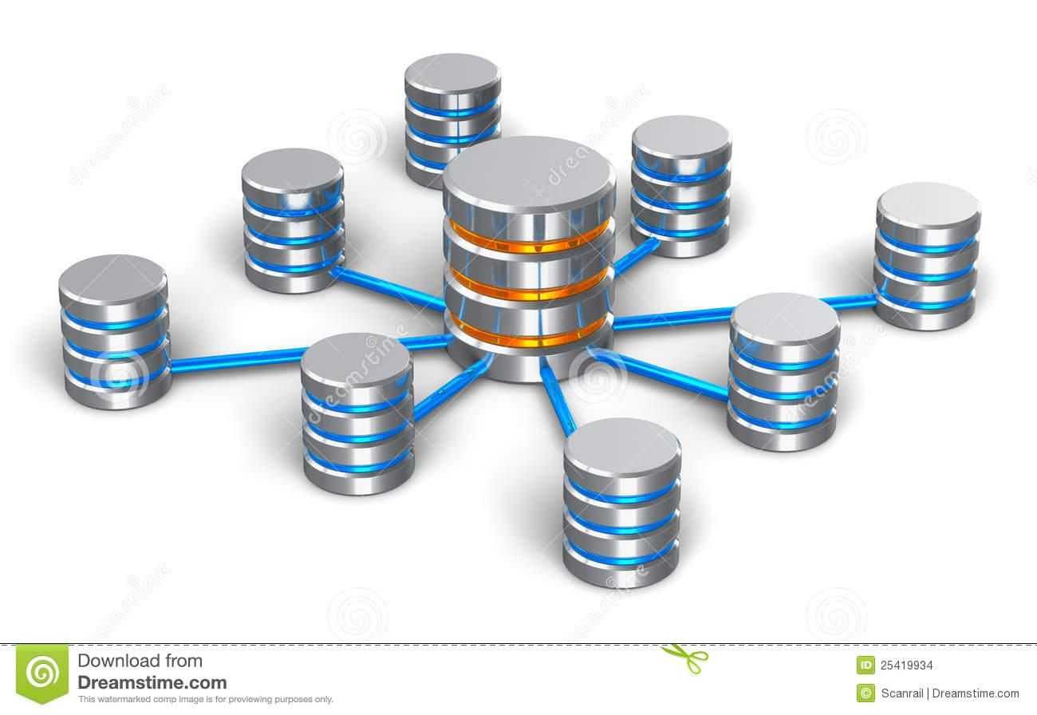
(2) Object-oriented databases
Information in an object-oriented database is represented in the form of objects, as in object-oriented programming.
(3) Network databases
• The network database model can be viewed as a netlike form where a single element can point to multiple data elements and can itself be pointed to by multiple data elements.

Slide 9
Data warehouses
A central repository for data, a data warehouse is a type of database specifically designed for fast query and analysis.
Cloud databases
A cloud database is a collection of data, either structured or unstructured, that resides on a private, public, or hybrid cloud computing platform.
Document/JSON database
Designed for storing, retrieving, and managing document-oriented information, document databases are a modern way to store data in JSON format rather than rows and columns.
Self-driving databases
The newest and most groundbreaking type of database, self-driving databases (also known as autonomous databases) are cloud-based and use machine learning to automate database tuning, security, backups, updates, and other routine management tasks traditionally performed by database administrators.

Slide 10
Relational Database (RDBMS)
A relational database is a type of database that stores and provides access to data points that are related to one another.
customer - customer’s name, address, shipping and billing information, phone number, and other contact information
customer order —each record includes the ID of the customer, the product ordered, the quantity, the selected size and color, and so on—but not the customer’s name or contact information.
These two tables have only one thing in common: the ID column (the key). But because of that common column, the relational database can create a relationship between the two tables.

Slide 11
Benefits of relational database management system
simple yet powerful relational model is used by organizations of all types and sizes for a broad variety of information needs.
Relational databases are used to track inventories, process ecommerce transactions, manage huge amounts of mission-critical customer information, and much more.
A relational database can be considered for any information need in which data points relate to each other and must be managed in a secure, rules-based, consistent way.

Slide 12
The relational model is the best at maintaining data consistency across applications and database copies (called instances).
Ex: when a customer deposits money at an ATM and then looks at the account balance on a mobile phone, the customer expects to see that deposit reflected immediately in an updated account balance.
Relational databases excel at this kind of data consistency, ensuring that multiple instances of a database have the same data all the time.
It’s difficult for other types of databases to maintain this level of timely consistency with large amounts of data.
for critical business operations such as shopping cart transactions, the relational database is still the gold standard.

Slide 13
Example
consider an inventory database that tracks three parts that are always used together. When one part is pulled from inventory, the other two must also be pulled. If one of the three parts isn’t available, none of the parts should be pulled—all three parts must be available before the database makes any commitment.
This multifaceted commitment capability is called atomicity.
Atomicity is the key to keeping data accurate in the database and ensuring that it is compliant with the rules, regulations, and policies of the business.

Slide 14
ACID properties and RDBMS
Atomicity defines all the elements that make up a complete database transaction.
Consistency defines the rules for maintaining data points in a correct state after a transaction.
Isolation keeps the effect of a transaction invisible to others until it is committed, to avoid confusion.
Durability ensures that data changes become permanent once the transaction is committed.

Slide 15
Stored procedures
Data access involves many repetitive actions.
relational databases allow stored procedures, which are blocks of code that can be accessed with a simple application call.
Database locking and concurrency
Locking prevents other users and applications from accessing data while it is being updated.
Concurrency manages the activity when multiple users or applications invoke queries at the same time on the same database. This capability provides the right access to users and applications according to policies defined for data control.

Slide 16
SQL (Structured Query Language)
SQL is a programming language used by nearly all relational databases to query, manipulate, and define data, and to provide access control.
SQL is Structured Query Language, which is a computer language for storing, manipulating and retrieving data stored in relational database.
SQL is a language of database, it includes database creation, deletion, fetching rows and modifying rows etc.
SQL is the standard language for Relation Database System. All relational database management systems like MySQL, MS Access, Oracle, Sybase, Informix, postgres and SQL Server use SQL as standard database language

Slide 17
Entity Relationship Diagram
An Entity–relationship model (ER model) describes the structure of a database with the help of a diagram, which is known as Entity Relationship Diagram (ER Diagram).
An ER model is a design or blueprint of a database that can later be implemented as a database. The main components of E-R model are: entity set and relationship set.
ER diagram has three main components:
1. Entity 2. Attribute 3. Relationship

Slide 18
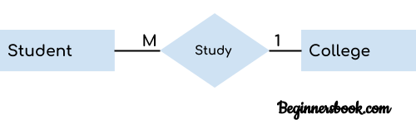
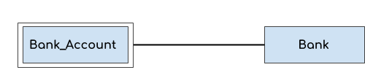
1. Entity
An entity is an object or component of data. An entity is represented as rectangle in an ER diagram.
For example: In the following ER diagram we have two entities Student and College and these two entities have many to one relationship as many students study in a single college.
Weak Entity:
An entity that cannot be uniquely identified by its own attributes and relies on the relationship with other entity is called weak entity. The weak entity is represented by a double rectangle. For example – a bank account cannot be uniquely identified without knowing the bank to which the account belongs, so bank account is a weak entity.

Slide 19
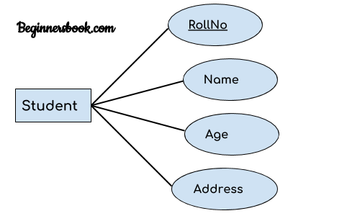
2. Attribute
An attribute describes the property of an entity. An attribute is represented as Oval in an ER diagram. There are four types of attributes:
1. Key attribute 2. Composite attribute 3. Multivalued attribute 4. Derived attribute
key attribute :
A key attribute can uniquely identify
an entity from an entity set.

Slide 20
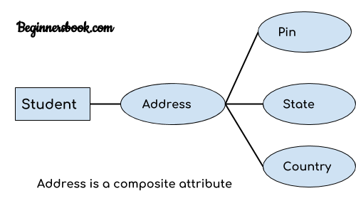
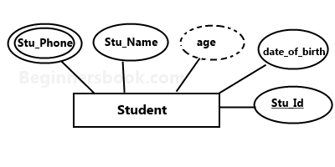
(2) Composite attribute:
An attribute that is a combination
of other attributes is known as
composite attribute.
(3) Multivalued attribute:
An attribute that can hold multiple
values is known as multivalued attribute.
It is represented with double ovals
in an ER Diagram.
(4) Derived attribute :
A derived attribute is one
whose value is dynamic
and derived from another attribute.
It is represented by dashed oval in an ER Diagram.

Slide 21
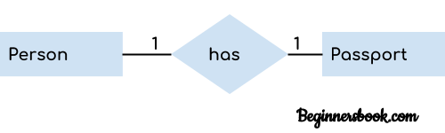
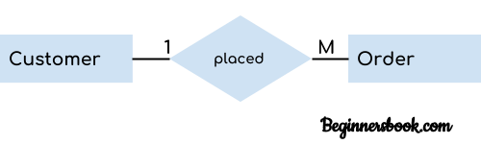
(3) Relationship
A relationship is represented by diamond shape in ER diagram,it shows the relationship among entities.
1. One to One 2. One to Many 3. Many to One 4. Many to Many
One to One Relationship
2. One to Many Relationship

Slide 22
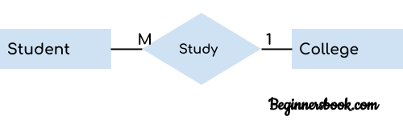
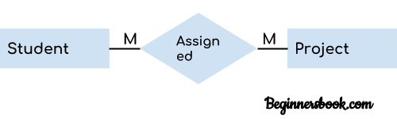
3. Many to One Relationship
4. Many to Many Relationship

Slide 23
keys
(1) primary key
A primary key is the column that contain values that uniquely identify each row in a table.
Primary keys must contain unique values.
A primary key column cannot have NULL values.
A table can have only one primary key, which may consist of single or multiple fields.
When multiple fields are used as a primary key, they are called a composite key.
If a table has a primary key defined on any field(s), then you cannot have two records having the same value of that field(s).

Slide 24
(2) Foreign Key
A foreign key is a key used to link two tables together. This is sometimes also called as a referencing key.
When, "one" table's primary key field is added to a related "many" table in order to create the common field which relates the two tables, it is called a foreign key in the "many" table.
Primary key
Product_id | Product_name | Price
1 | Laptop | 55000
2 | Mobile | 25000
3 | HeadPhone | 5000
Customer_id | Customer_name | City
1 | Parth | Surat
2 | Jay | Surat
Foreign key
Order_id | Order_date | Product_id | Customer_id
1 | 12-12-2021 | 1 | 1
2 | 23-2-2017 | 1 | 1
Primary key

Slide 25
Unique Key
A unique key is a set of one or more than one fields/columns of a table that uniquely identify a record in a database table.
You can say that it is little like primary key but it can accept only one null value and it cannot have duplicate values.
The unique key and primary key both provide a guarantee for uniqueness for a column or a set of columns.
Customer_id | Customer_name | phone | City
1 | Parth | 9874563210 | Surat
2 | Jay | 9654785213 | Surat
3 | Dhiren |  | Vapi
4 | Ankit | 9632587412 | Mumbai

Slide 26
SQL
SQL (pronounced sequel) is the set-based, high-level declarative computer language with which all programs and users access data in an database.
SQL statements type
• DDL – Data Definition Language
• DML – Data Manipulation Language
• DCL – Data Control Language
• DQL – Data Query Language

Slide 27
DDL - Data Definition Language
command | description
CREATE | Creates a new table, a view of a table, or other object in database
ALTER | Modifies an existing database object, such as a table.
DROP | Deletes an entire table, a view of a table or other object in the database.
• SQL CREATE TABLE STATEMENT
CREATE TABLE table_name( column1 datatype, column2 datatype, column3 datatype, ..... , columnN datatype, PRIMARY KEY( one or more columns ) );
• SQL DROP TABLE STATEMENT
DROP TABLE table_name;
• SQL TRUNCATE TABLE STATEMENT
TRUNCATE TABLE table_name;

Slide 28
• SQL ALTER TABLE STATEMENT
ALTER TABLE table_name{ADD|DROP|MODIFY}column_name{data_ype};
• SQL ALTER TABLE STATEMENT (RENAME)
ALTER TABLE table_name RENAME TO new_table_name;

Slide 29
DML - Data Manipulation Language
command | description
Insert | Creates a record
Update | Modifies records
Delete | Deletes records
• SQL INSERT INTO STATEMENT
INSERT INTO table_name( column1, column2....columnN) VALUES ( value1, value2....valueN);
• SQL UPDATE STATEMENT
UPDATE table_name SET column1 = value1, column2 = value2....columnN=valueN [ WHERE CONDITION ];
• SQL DELETE STATEMENT
DELETE FROM table_name WHERE {CONDITION};

Slide 30
DQL – Data Query Language
Command | Description
SELECT | to select data from a database.
SQL SELECT STATEMENT
SELECT * FROM table_name;
SELECT CustomerName, City FROM Customers;
only distinct (different) values.
SELECT DISTINCT Country FROM Customers;

Slide 31
WHERE Syntax
SELECT column1, column2, ...
FROM table_name
WHERE condition;
SELECT * FROM Customers
WHERE Country='Mexico';
operator =,<,>,<=,>=,<>, between, like, in, not in
SELECT * FROM Products
WHERE Price BETWEEN 50 AND 60;

Slide 32
SELECT * FROM Customers
WHERE City LIKE 's%';
SELECT * FROM Customers
WHERE City IN ('Paris','London');
SELECT * FROM Customers
WHERE Country IN (SELECT Country FROM Suppliers);
SELECT * FROM Customers
WHERE CustomerName LIKE 'a%';
'%a'
'%or%';
'_r%'

Slide 33
SELECT * FROM Customers
ORDER BY CustomerName ASC;
SELECT * FROM Customers
ORDER BY CustomerName DESC;
SELECT COUNT(CustomerID), Country
FROM Customers
GROUP BY Country;
SELECT COUNT(CustomerID), Country
FROM Customers
GROUP BY Country
ORDER BY COUNT(CustomerID) DESC;
SELECT COUNT(CustomerID), Country
FROM Customers
GROUP BY Country
HAVING COUNT(CustomerID) > 5;

Slide 34
DCL – Data Control Language
Command | Description
Commit
Rollback

Slide 35
JOIN
A JOIN clause is used to combine rows from two or more tables, based on a related column between them.
Different Types of SQL JOINs
Here are the different types of the JOINs in SQL:
(INNER) JOIN: Returns records that have matching values in both tables
LEFT (OUTER) JOIN: Returns all records from the left table, and the matched records from the right table
RIGHT (OUTER) JOIN: Returns all records from the right table, and the matched records from the left table
FULL (OUTER) JOIN: Returns all records when there is a match in either left or right table

Slide 36
Function
SQL has many built-in functions for performing calculations on data. They are divided into 2 categories: 1. Aggregate Function 2. Scalar Function
1. Aggregate Function
2. Scalar Function

Slide 37
Aggregate Function
SELECT AVG(AGE) AS AvgAge FROM Students;
SELECT COUNT(*) AS NumStudents FROM Stuents;
SELECT MAX(MARKS) AS MaxMarks FROM Students;
SELECT SUM(MARKS) AS TotalMarks FROM Stuents;

Slide 38
Scalar Function
SELECT UCASE(NAME) FROM Students;
SELECT MID(NAME,1,4) FROM Students;
SELECT LENGTH(NAME) FROM Stuents;
SELECT ROUND(MARKS,0) FROM table_name;
SELECT NAME, NOW() AS DateTime FROM Students;
SELECT NAME, FORMAT(Now(),'YYYY-MM-DD') AS Date FROM Students;

Slide 39
PROCEDURE
A procedure is a group of PL/SQL statements that you can call by name.
A stored procedure is a prepared SQL code that you can save, so the code can be reused over and over again.
You can also pass parameters to a stored procedure, so that the stored procedure can act based on the parameter value(s) that is passed.

Slide 40
-- stored procedure
DELIMITER //
CREATE PROCEDURE GetAllProducts()
BEGIN
SELECT * FROM product;
END //
DELIMITER ;
call GetAllProducts

Slide 41
-- parameterise stored procedure
Delimiter //
create procedure selectCustomer(in city varchar(50),in name varchar(50))
begin
select * from customer where cust_city=city and cust_name=name;
end //
delimiter ;
call selectCustomer('surat','manish')

Slide 42
Trigger
Triggers are procedures that are stored in the database and implicitly run, or fired, when something happens.
Traditionally, triggers supported the execution of a PL/SQL block when an INSERT, UPDATE, or DELETE occurred on a table or view.
For example, a trigger can be invoked when a row is inserted into a specified table.
Benefits of Triggers
Triggers can be written for the following purposes −
Generating some derived column values automatically
Enforcing referential integrity
Event logging and storing information on table access
Auditing
Synchronous replication of tables
Imposing security authorizations
Preventing invalid transactions

Slide 43
DELIMITER //
CREATE TRIGGER contacts_after_insert
AFTER INSERT
ON contacts FOR EACH ROW
BEGIN
DECLARE vUser varchar(50);
-- Find username of person performing the INSERT into table
SELECT USER() INTO vUser;
-- Insert record into audit table
INSERT INTO contacts_audit
( contact_id,created_date,created_by)
VALUES
( NEW.contact_id,SYSDATE(),vUser );
END; //
DELIMITER ;

Slide 44
Cursor
Cursor is a pointer to a context area. The context area is basically a memory space for processing an SQL statement.
On executing the statement the cursor holds the returned result set which can contain single or multiple rows.
MySQL cursor is read-only, non-scrollable and asensitive.
Read-only: you cannot update data in the underlying table through the cursor.
Non-scrollable: You cannot fetch rows in the reversed order. you cannot skip rows or jump to a specific row in the result set.
Asensitive: there are two kinds of cursors: asensitive cursor and insensitive cursor. An asensitive cursor points to the actual data, whereas an insensitive cursor uses a temporary copy of the data.
An asensitive cursor performs faster than an insensitive cursor because it does not have to make a temporary copy of data. However, any change that made to the data from other connections will affect the data that is being used by an asensitive cursor, therefore, it is safer if you do not update the data that is being used by an asensitive cursor. MySQL cursor is asensitive.

Slide 45
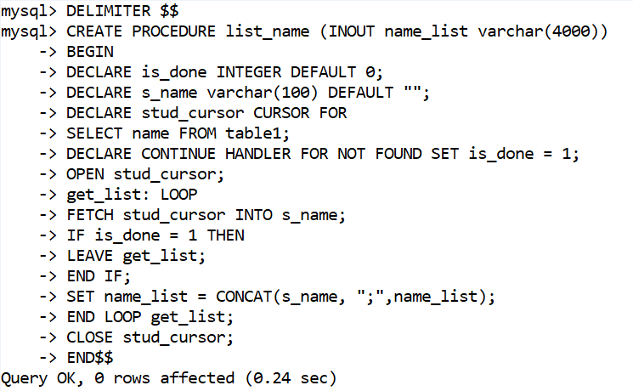

Slide 46
